Slide 1
Overview and Trends In the BioPharma Financing Market Biotech CEO Summit
Chris Ehrlich, Managing Director
chris@locustwalk.com
July 13, 2016
Boston | San Francisco | Tokyo | locustwalk.com

Slide 2
Executive Summary
Over the past few years, the biotech financing environment has undergone a number of significant structural changes:
Reduction in the number and size of traditional venture capital funds
Emergence of a powerful class of “family office” investors
Increasingly importance of “cross-over” investors
The comings and goings and (perhaps) comings again of an IPO market
To date, 2016 appears to be a bit of a “shake-out” year as a result of:
Increased general market volatility
Market shock due to “Brexit”
Impending concern around upcoming presidential elections
So far this year we are seeing these “forces” have the following impact:
Significantly fewer biopharma IPO’s than in the previous two years
A corresponding reduction in cross-over activity
Renewed interest by recently-raised VC funds in Series A investing
This panel will seek to explore the implications of these factors on fundraising strategies and hopefully provide useful tips on how best to navigate the current environment

Slide 3
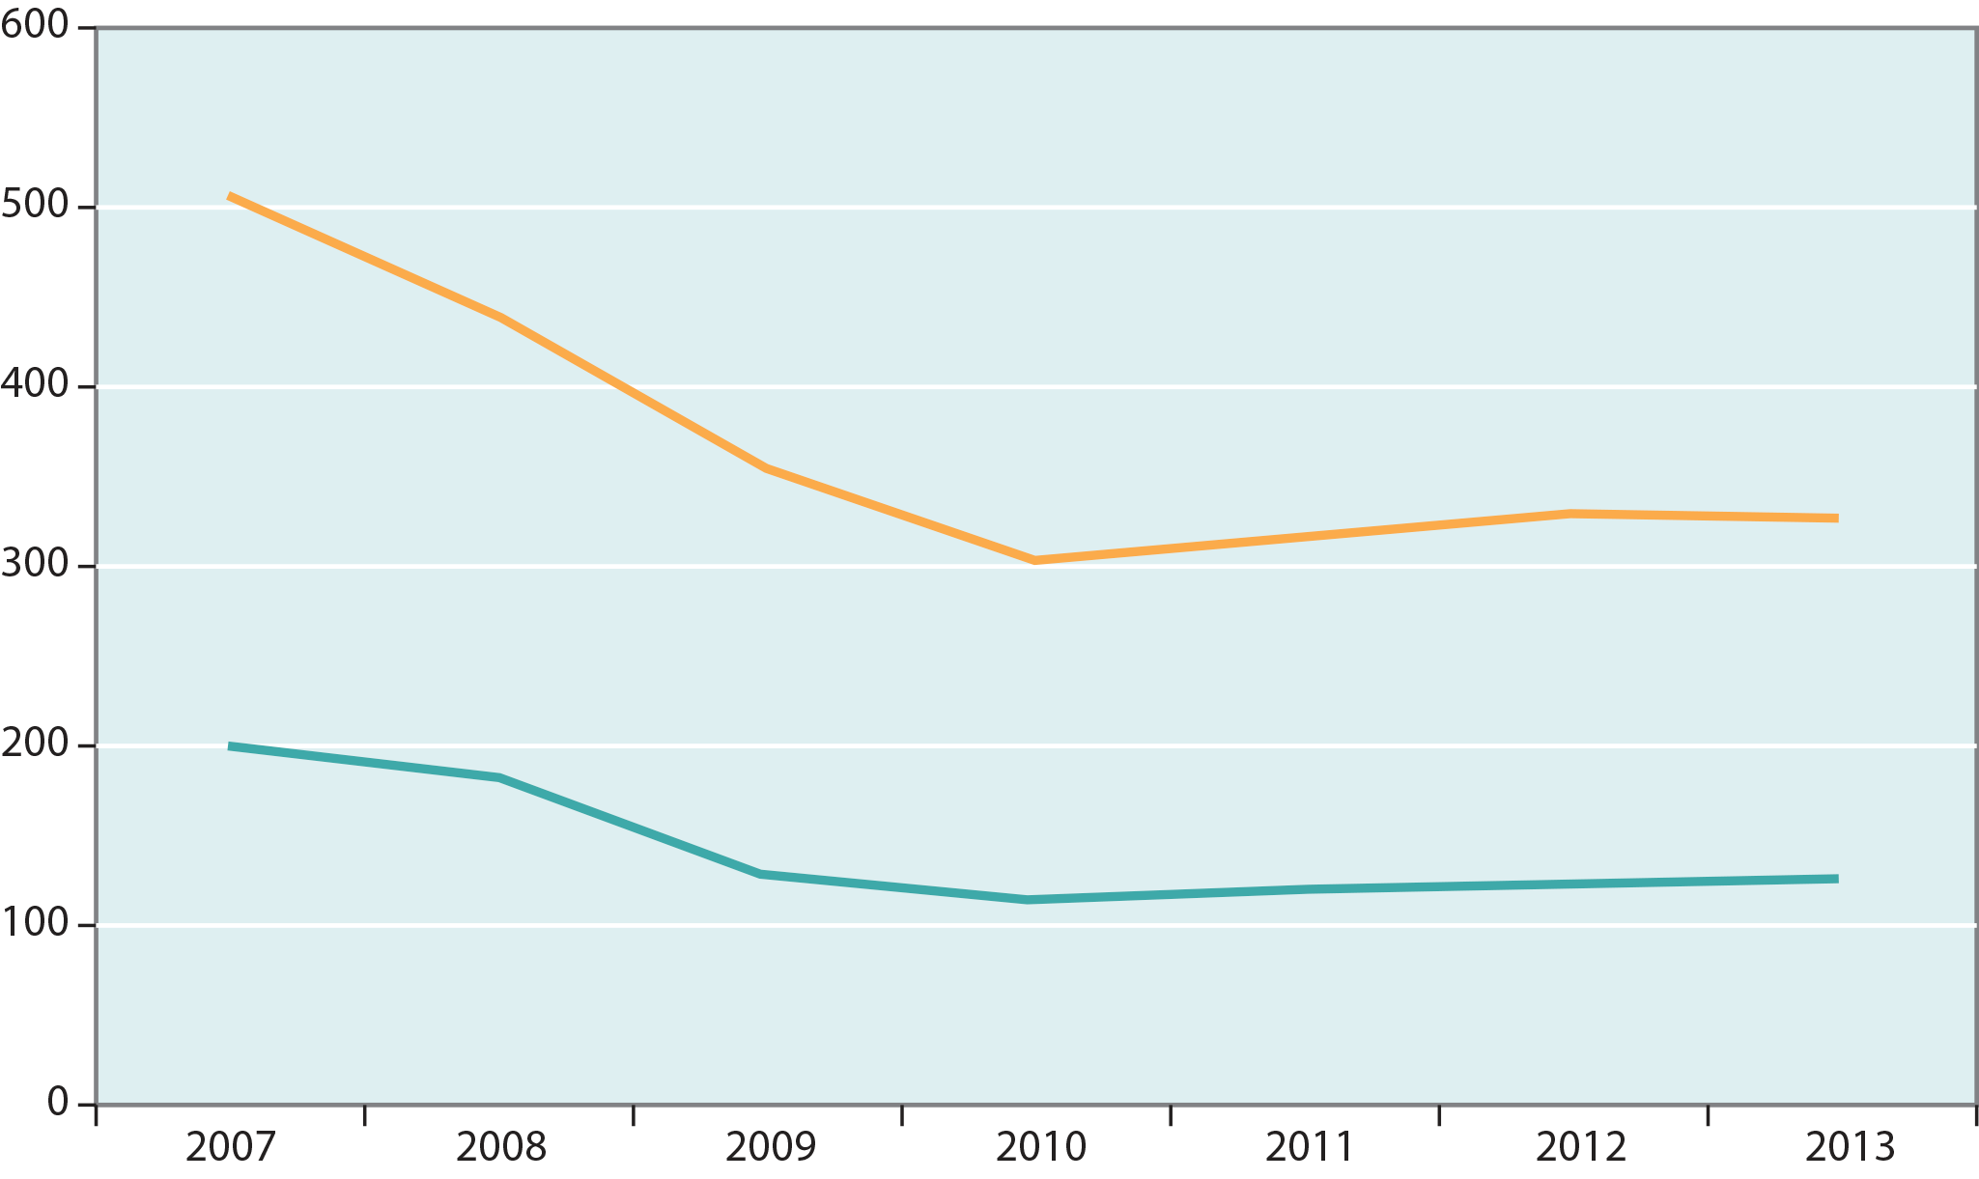
Over the past decade, the number of active biopharma venture capital firms has significantly declined
Alternative Financing: Family Offices
Number of Biotech VC Investors
BioPharma – Seed/First Round
BioPharma – Total
Only ~ 25 active Healthcare VCs
Source: VentureSource, Flag Capital

Slide 4
In fact, many VC funds have changed their branding to distance themselves from the asset class
Notes:
As a result, a number of those firms that are moving forward have made a conscious, albeit subtle, effort to rebrand themselves in a way that distances them from the venture moniker.

Slide 5
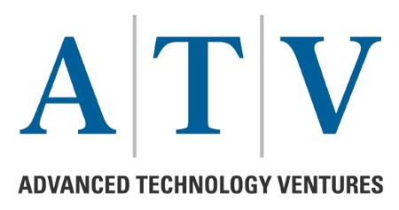
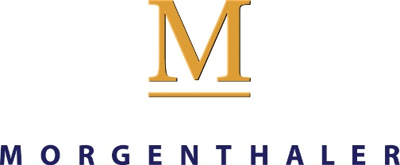
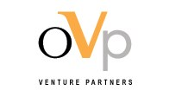
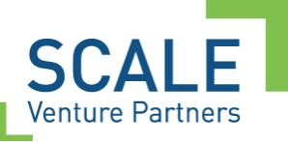
…and quite a few have either shut down, merged or significantly reduced their activities
Source: CNN, Xconomy
Notes:
And, those are the lucky ones. Quite a few have, as recently as early this month, either shut down their life sciences operations, merged in an attempt to survive or significantly reduced their commitments to the life sciences, in general.

Slide 6
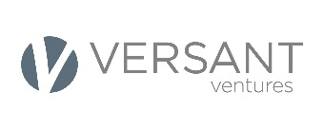
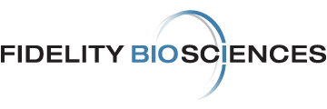
For the handful VC’s that were able to raise new funds, there appears to have been a renewed interest in Series A financings
Most Active New VC Investors in Biopharma 2014-15
U.S. Company Formation: Deals and Investments in Series A Biopharma
Investor | Deals | Total $ Raised
 | 30 | $1,300M
 | 20 | $736M
 | 19 | $713M
 | 16 | $376M
 | 15 | $742M
 | 12 | $586M
 | 11 | $705M
 | 11 | $630M
 | 10 | $236M
 | 10 | $143M
Number of Deals
Total Series A ($M) | $776 | $1,102 | $823 | $1,871
CVC* Deal % / # | 22% / 17 | 29% / 17 | 27% / 22 | 29% / 28
CVC = Crossover investors
Source: Silicon Valley Bank Trends in Healthcare Investments and Exits

Slide 7
…and in 1H 2016, we observe a continuation of this trend
Amount Raised and Median Deal Value in Series A First Half 2016 vs First Half 2015
Series A | 1H 2015 (Q1+Q2) | 1H 2016 (Q1+Q2) | % Change
Total Raise | $899M | $985.1M | +9.5%
Deals | 44 | 40 | -9.1%
Median Deal | $15M | $22M | +46.7%
Clinical Stage Companies | 20% | 28% | +8%
Source: BioWorld

Slide 8
Biopharma has clearly emerged as the key focus area for healthcare investors
U.S. Company Formation: Deals and Investments in Series A
BioPharma
2012 | 2013 | 2014 | 2015
Biopharma Series A investment amounts skyrocketed, fueled by considerably larger deal sizes
36% of deals raised at least $20 million.
Declining investor interest in devices led to a drop in new company formations
The majority of Series A rounds were less than $5 million
Dx/tools faced challenges, including
Commercial reimbursement issues
Regulatory uncertainty
Difficulty protecting IP
Total Series A ($M) | $776 | $1,102 | $823 | $1,871
CVC Deals % / # | 22% / 17 | 29% / 17 | 27% / 22 | 29% / 28
Device
2012 | 2013 | 2014 | 2015
Total Series A ($M) | $212 | $215 | $327 | $96
CVC Deals % / # | 9% / 3 | 18% / 6 | 15% / 6 | 32% / 7
DX/Tools
2012 | 2013 | 2014 | 2015
Total Series A ($M) | $331 | $257 | $354 | $165
CVC Deals % / # | 4% / 2 | 11% / 5 | 9% / 4 | 24% / 4
Source: Silicon Valley Bank Trends in Healthcare Investments and Exits

Slide 9
At the early stages, families have stepped in to fill the void left by fewer VCs
Alternative Financing: Family Offices

Slide 10
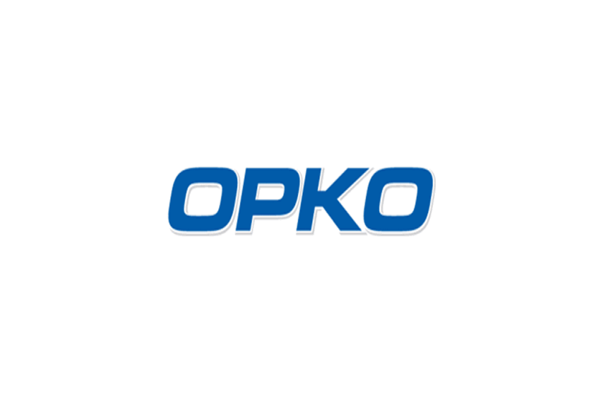
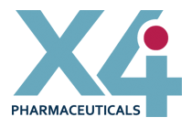
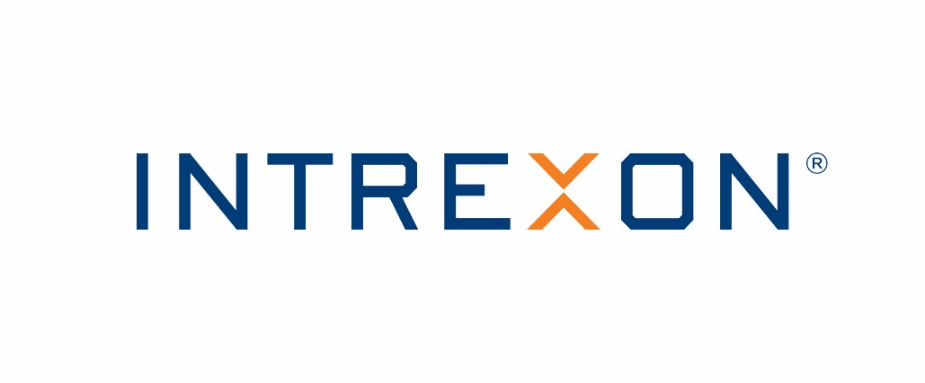
With companies backed by families demonstrating some success
Alternative Financing: Family Offices

Slide 11
“Crossover” investors played increasingly important role in 2013-5, but, even their activity has slowed recently
Top Crossover Investors by Deals 2013-15
CROSSOVER INVESTOR | 2013 | 2014 | Q1’15 | Q2’15 | Q3'15 | Q4'15 | 2013-15
RA Capital | 4 | 12 | 7 | 5 | 9 | 5 | 42
Rock Springs Capital | 1 | 8 | 5 | 5 | 7 | 6 | 32
Deerfield Management | 5 | 11 | 1 | 5 | 3 | 4 | 29
Foresite Capital | 4 | 5 | 3 | 4 | 4 | 5 | 25
Fidelity Investments | 0 | 2 | 3 | 4 | 11 | 4 | 24
Cormorant | 0 | 0 | 0 | 5 | 8 | 5 | 18
Jennison Associates | 1 | 3 | 3 | 3 | 7 | 1 | 18
Perceptive Advisors | 1 | 6 | 1 | 4 | 2 | 4 | 18
EcoR1 Capital | 1 | 4 | 2 | 3 | 5 | 1 | 16
Redmile Group | 2 | 7 | 0 | 2 | 3 | 2 | 16
Casdin Capital | 4 | 2 | 0 | 5 | 2 | 3 | 16
Wellington Management | 0 | 5 | 2 | 5 | 1 | 2 | 15
Adage Capital Management | 1 | 6 | 2 | 0 | 2 | 1 | 12
Woodford Investment | 0 | 4 | 0 | 3 | 4 | 0 | 11
Sabby Capital | 0 | 6 | 1 | 1 | 1 | 0 | 9
Total Deals | 24 | 81 | 30 | 54 | 69 | 43 | 301
The top 15 crossover investors poured more than $1.2 billion into private venture-backed healthcare companies in 2015
Crossover activity peaked in Q3 at 69 deals
Each of the top 10 biopharma deals in Q3 raised more than $75M
8 of the 10 deals included at least one crossover investor
However, the pace of investment by crossovers slowed abruptly in Q4
Looking ahead, we expect these investors to continue to cautiously invest, but grow more focused on moving their private portfolio companies into the public markets
15 new investments by Top Crossovers in 2016 through 2/19 (versus 43 in Q4)
Sources: CB Insights, press releases, PitchBook and SVB proprietary data

Slide 12
Companies with crossover investors significantly outperformed on IPO’s
Pre-Money IPO Valuation ($, Millions)
Step-up Multiple from Last Round Into the IPO Valuation
Post-IPO Stock Performance (% Change)
With Crossover Investors
Without Crossover Investors
By 2015, it was estimated that 67% of funding in the top-10 biotech deals of Q2 came from non-venture sources, like cross-over investors
Source: Life Sci VC – The Biotech Cross-Over Phenom: Biomarker of Quality?

Slide 13
2013-15 witnessed one of the most significant IPO bull-runs in recent history
Total Therapeutic IPOs on US Exchange
Total Amount Raised ($USD B)
Sources: Thomson Reuters Life Sciences Dealmaking 2015; HBM Pharma/Biotech M&A Report 2016

Slide 14
However, the 2015 class of IPOs have begun to struggle
Offer to Current Performance for 2015 Life Sciences IPOs
Mean: -40%
Median: -48%
Source: Yahoo! Finance. Note: Prices as of 2016-05-18.

Slide 15
In fact, in Q1 2016, the US IPO market hit its lowest levels since 2008-9
LTM IPO Aftermarket Performance
Healthcare aftermarket performance has suffered as accounts are limiting their biopharma exposure due to overall negative market conditions
Source: Stifel Capital Markets

Slide 16
Resulting in only 17 Lifescience IPO’s in 2016
Issuer | Therapeutic Area | Phase of Lead Product | Offer Date | Public Offering Price ($) | Insider Participation | Price Change to Current
Syros Pharmaceuticals | AML and MDS | Phase 2 Ready | 6/29/16 | 12.50 | 70.0% | 45.2%
Selecta Biosciences | Gout | Phase 1 Ongoing | 6/21/16 | 14.00 | 57.1% | (0.1%)
Clearside Biomedical | Macular Edema | Phase 3 Ongoing | 6/1/16 | 7.00 | 54.5% | 0.1%
Reata Pharma | PAH | Phase 3 Ongoing | 5/25/16 | 11.00 | 48.3% | 79.6%
Merus BV | Oncology | Phase 1/2 | 5/18/16 | 10.00 | 59.1% | (20.1%)
PhaseRx Inc | Orphan Liver Disease | Preclinical | 5/17/16 | 5.00 | 50.8% | (16.4%)
Oncobiologics | Immunology/Oncology | Phase 3 Ready | 5/12/16 | 6.00 | 57.1% | (23.0%)
Intellia Therapeutics | Gene Therapy | Preclinical | 5/6/16 | 18.00 | 28.0% | 18.6%
Spring Bank Pharmaceuticals | Infectious Disease | Phase 2 Ready | 5/6/16 | 12.00 | 54.3% | (21.3%)
Aeglea BioTherapeutics | Oncology/Orphan | Phase 1 Ready | 4/7/16 | 10.00 | 63.5% | (51.4%)
Corvus Pharmaceuticals | Oncology | Phase 1/1b | 3/22/16 | 15.00 | 30.1% | (4.9%)
Hutchinson China MediTech | Oncology | Phase 3 Ready | 3/16/16 | 13.50 | 0.0% | 2.2%
Syndax Pharmaceuticals | Oncology | Phase 3 | 3/2/16 | 12.00 | 0.0% | (17.9%)
AveXis | Gene Therapy/ Orphan | Phase 1 | 2/10/16 | 20.00 | 20.0% | 90.1%
Proteostasis Therapeutics | Endocrinology/ Metabolism | Phase 1 Ready | 2/10/16 | 8.00 | 40.4% | 51.6%
BeiGene | Oncology | Phase 1 | 2/2/16 | 24.00 | 39.8% | 24.2%
Editas Medicine | Gene Therapy | Preclinical | 2/2/16 | 16.00 | 0.0% | 52.5%
 |  |  |  | Mean | 39.6% | 12.3%
 |  |  |  | Median | 48.3% | 0.1%
Source: BTIG Research, Stifel Capital Markets

Slide 17
What to expect in the second half of 2016 and beyond…
Success for VC funds in 2015 suggests an optimistic outlook for financing biotech start-ups
After the 2014-5 IPO boom, VCs got the exits they needed to refill their coffers
This has resulted in increased activity at the Series A level
Key question: what does the future hold for the VC industry?
It’s anyone’s guess as to the future of a biotech IPO “window”
However, there’s a great deal of pressure relative to the upcoming presidential election
Anticipate a reduction of activity in August as people begin to worry about pricing and reimbursement legislation
Key Question: What is the outlook for biotech IPO’s in 2016 and beyond?
Key Question: How does the panel envision the role of “crossover investors” going forward?
Family office investors have emerged as a powerful new source of capital
Key Question: But is it sustainable?
Strategic investors may also continue to fill the gap left by fewer VC’s
Key Question: What is the panel’s perception about the value of strategic investors?
Key Question: Is it better to have just one or several?
If the IPO market remains unsteady, many companies will seek to explore alternative sources of financing like reverse mergers or venture debt.
Key question: What are the relative pro’s and con’s of each alternative?

